Slide 1

CASCON 2024 Tutorial: Develop Explainable AI Services on Cloud Computing and Open Source Models
Presenter: Zerui Wang
November 13, 2024
Notes:
Dates

Slide 2

Agenda
Segment 1: Theoretical Foundations (45 minutes)
Segment 2: XAI Service Operation (45 minutes)
Segment 3: XAI Application Scenarios and Future Directions (45 minutes)
Q&A and Discussion (15 minutes)
Image generated by DALLE 3

Slide 3
Segment 1: Theoretical Foundations of XAI

Slide 4

AI Industry Growth Rate
The global artificial intelligence market size was valued at USD 136.55 billion in 2022 and is projected to expand at a CAGR of 37.3% from 2023 to 2030. Generative AI Could Raise Global GDP by 7%.
Boarder Domain Application
The continuous research and innovation by tech giants are driving the adoption of advanced technologies in various industries, such as healthcare, retail, finance, manufacturing, and automotive.
The Black-Box Problem
The 'Black-Box' nature of AI refers to the lack of transparency and interpretability in AI models, especially deep learning architectures.
Trust Issues: Users may not trust or adopt AI solutions if they don’t understand how decisions are made.
Ethical Concerns: Potential for unintended biases and discriminatory decisions without clarity on how AI reaches its conclusions.
Image generated by DALLE 3
Artificial Intelligence Market Size, Share, Growth Report 2030. Retrieved October 28, 2023, from https://www.grandviewresearch.com/industry-analysis/artificial-intelligence-ai-market
Generative AI Could Raise Global GDP by 7%. Retrieved 2023, October 25. Goldman Sachs. https://www.goldmansachs.com/intelligence/pages/generative-ai-could-raise-global-gdp-by-7-percent.html Asatiani, A., Malo, P., Nagbøl, P. R., Penttinen, E., Rinta-Kahila, T., & Salovaara, A. (2020). Challenges of explaining the behavior of black-box AI systems. MIS Quarterly Executive, 19(4), 259-278.

Slide 5
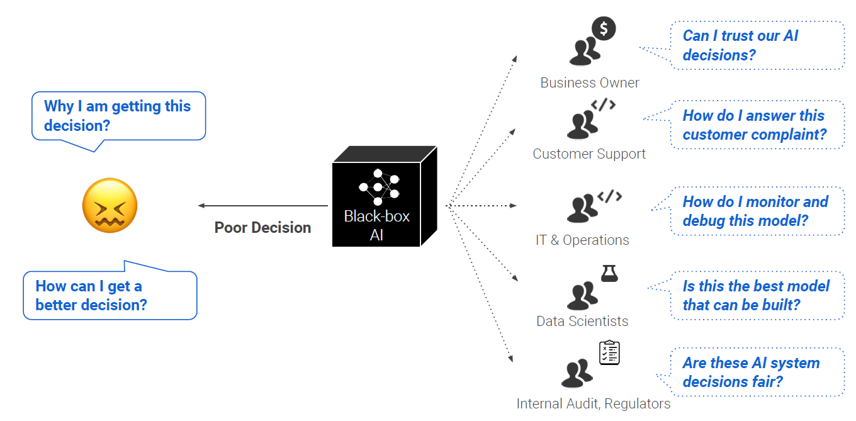
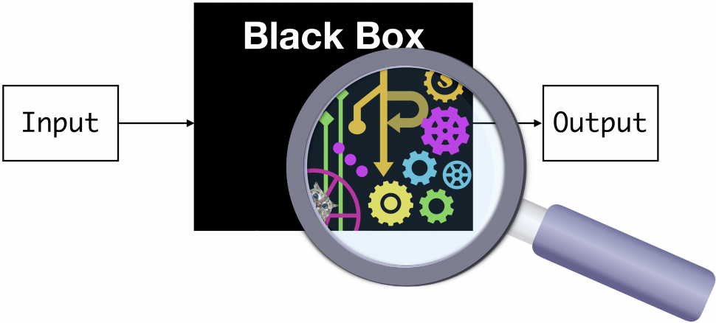

Why AI should be explainable?
https://blog.ml.cmu.edu/2019/05/17/explaining-a-black-box-using-deep-variational-information-bottleneck-approach/

Slide 6
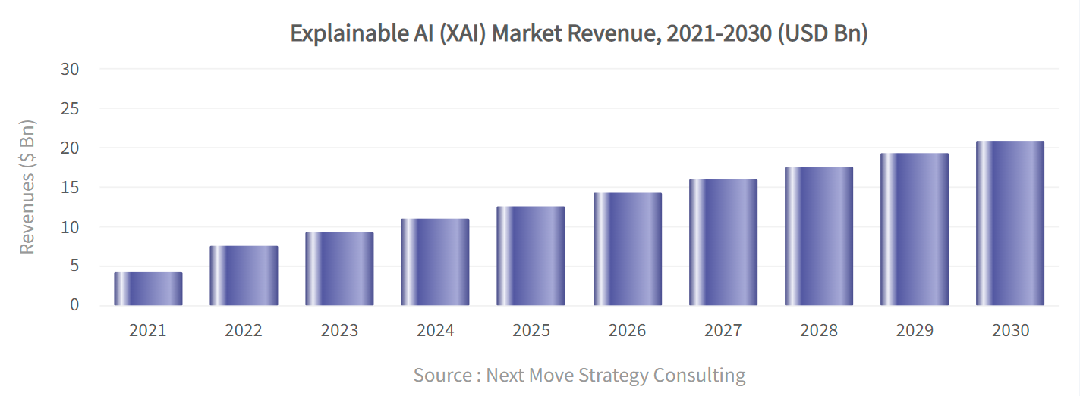
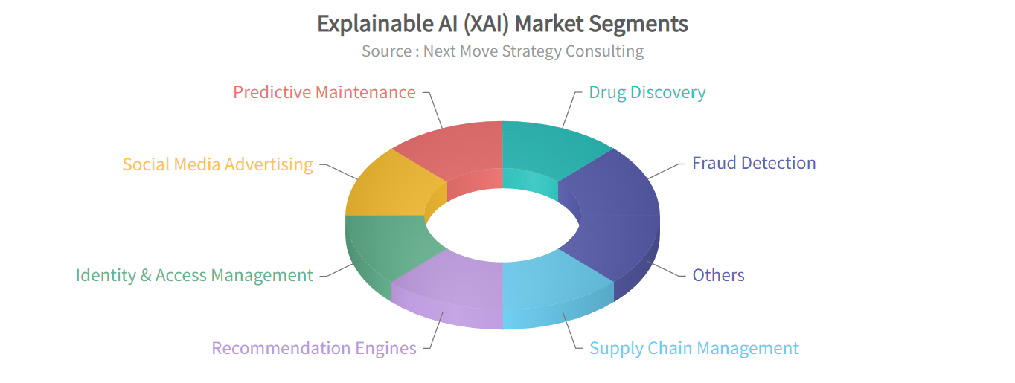

Size of explainable artificial intelligence (XAI) market

Slide 7
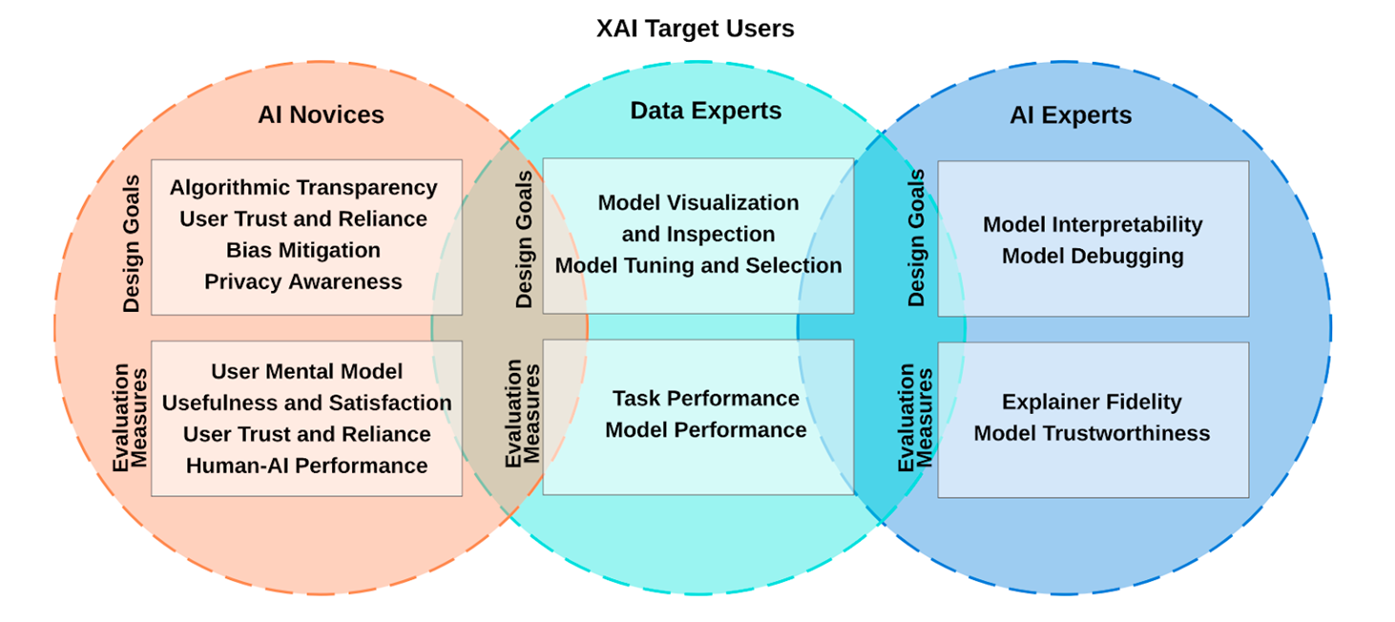
Goals for Explainable Artificial Intelligence
A summary of categorization of XAI design goals and evaluation measures between user groups.
Sina Mohseni, Niloofar Zarei, and Eric D. Ragan. 2021. A Multidisciplinary Survey and Framework for Design and Evaluation of Explainable AI Systems. ACM Trans. Interact. Intell. Syst. 11, 3–4, Article 24 (December 2021), 45 pages. https://doi.org/10.1145/3387166

Slide 8
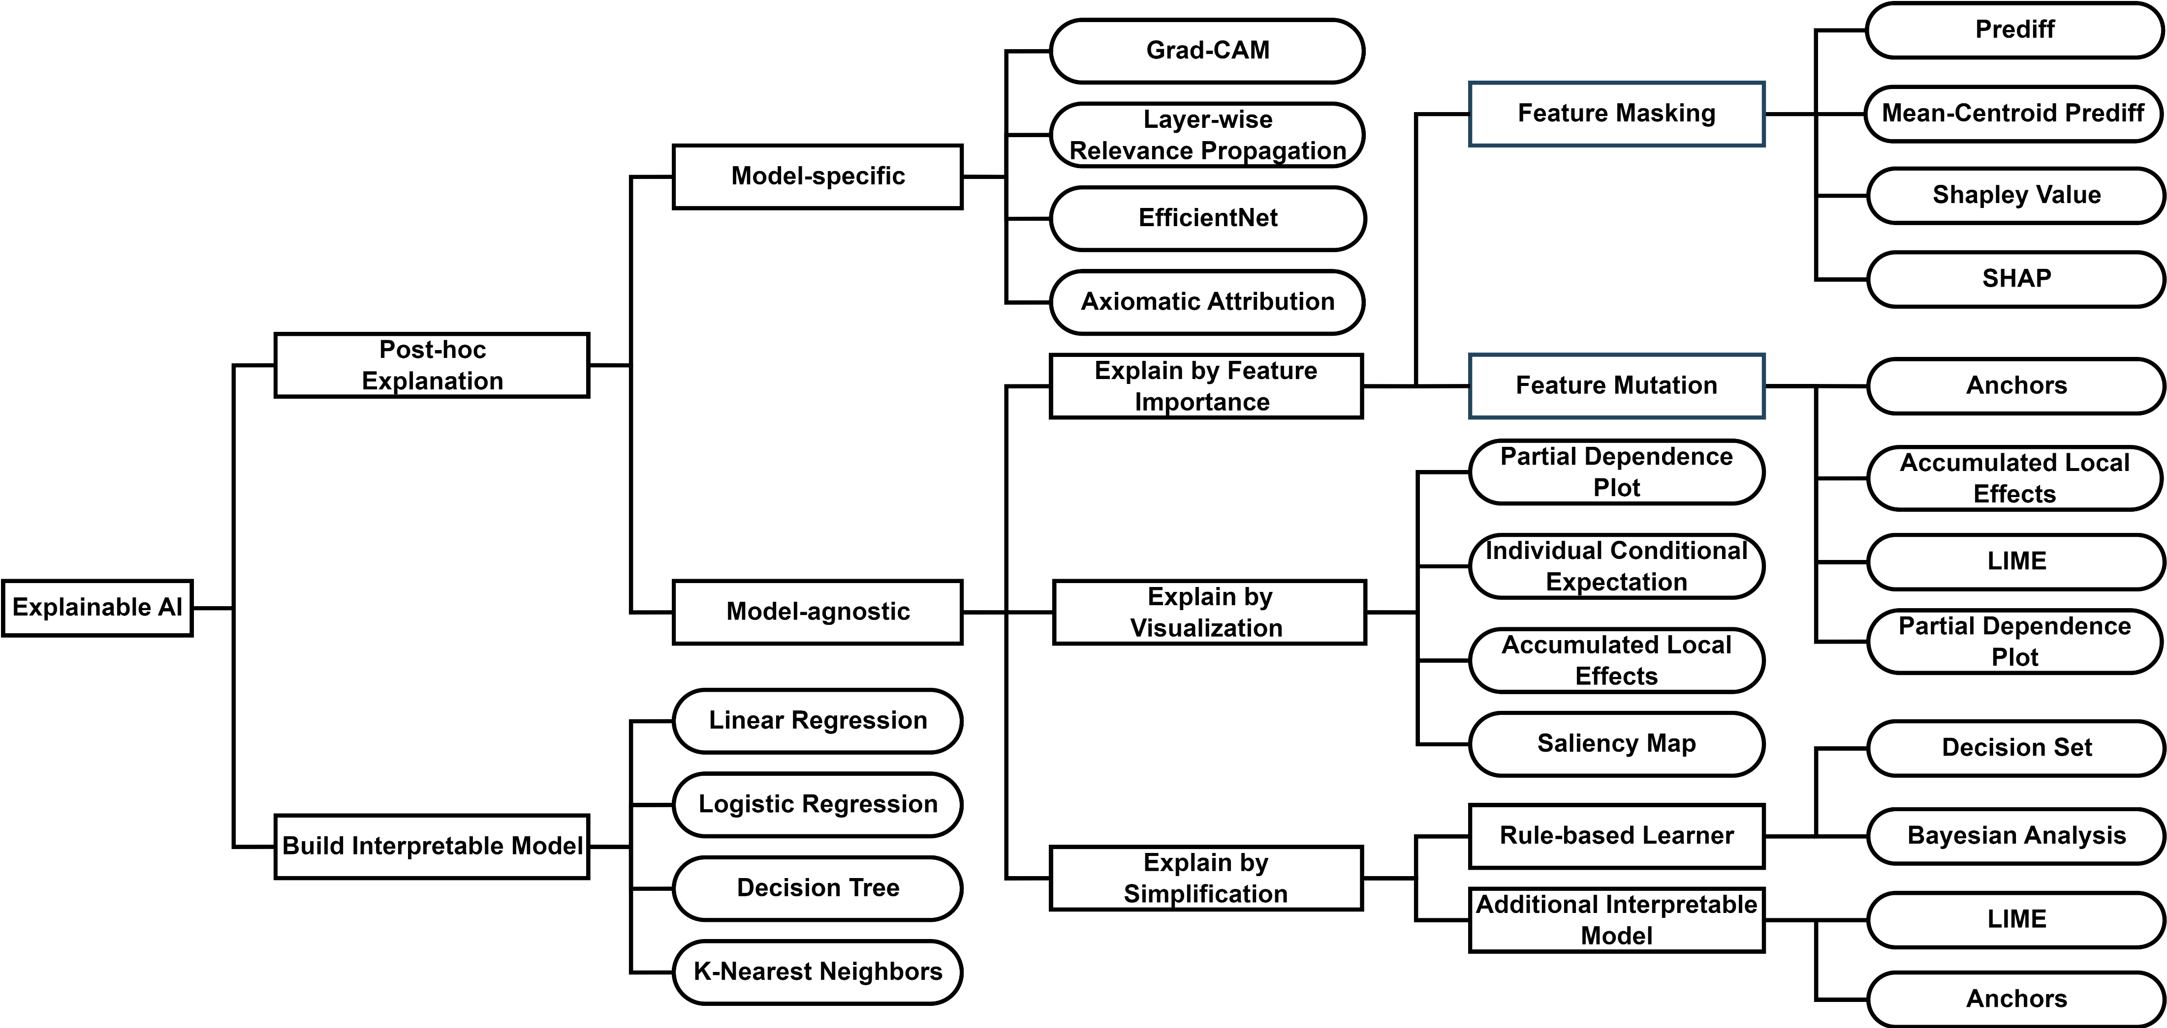
XAI methods taxonomy
XAI should enable the user to understand, trust, and manage the latest AI models.
The XAI methods taxonomy
J. Huang, Z. Wang, D. Li, and Y. Liu, “The analysis and development of an xai process on feature contribution explanation,” in 2022 IEEE International Conference on Big Data (Big Data), 2022, pp. 5039–5048.
*References for all of these methods can be found in the report.

Slide 9
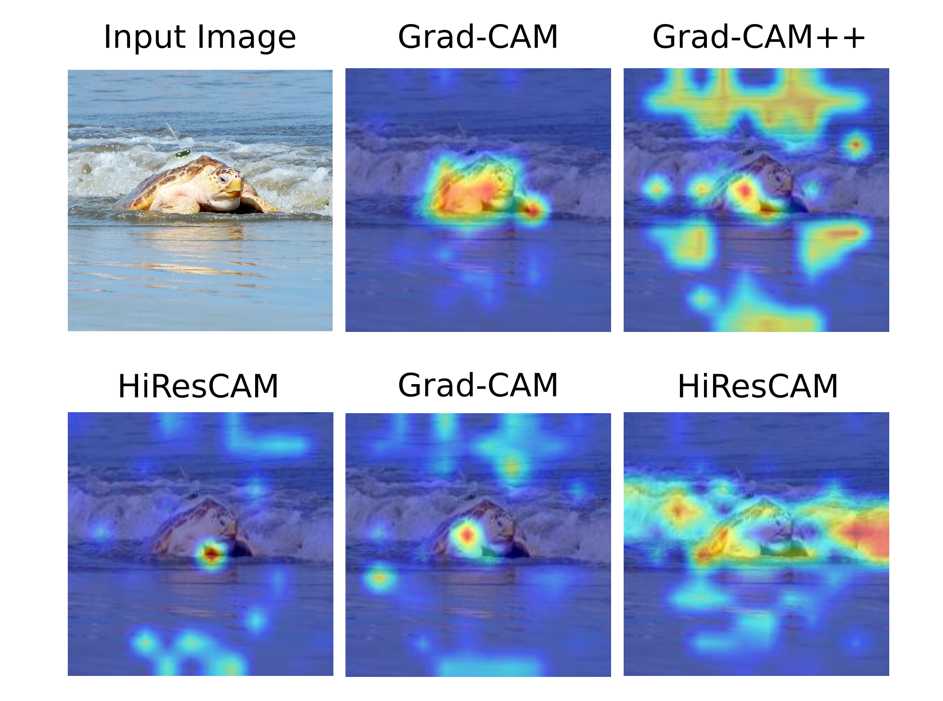
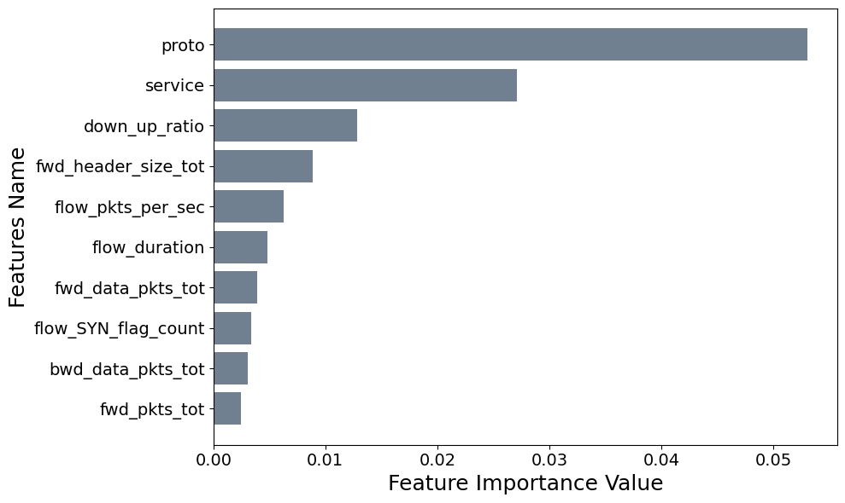
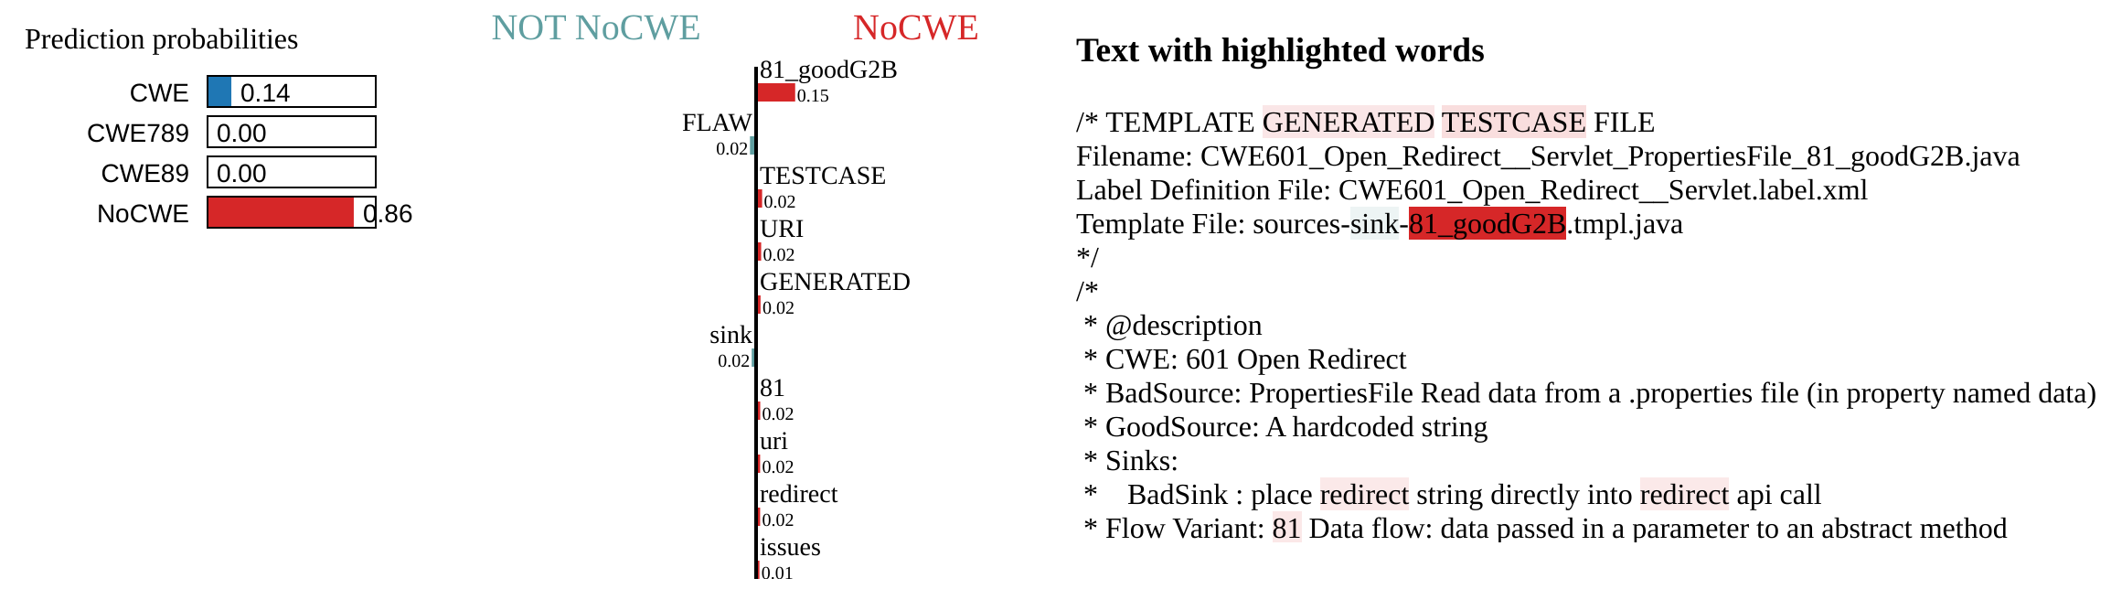
Feature Importance Explanations from Explainable AI (XAI)
Explanations for vision model
Explanations for tabular model
Explanations for text model
Notes:
Let me show you the examples of XAI results in different tasks.
In the computer vision, XAI often generates visual explanations for AI model decisions. For example, in the figure on the slide, you can see different CAM-based visual explanations derived from the Vision Transformer model. These explanations highlight the important regions of an image that influenced the model's prediction.
For structured data, XAI methods Mean Centroid Prediff and SHAP are widely accepted. These methods assess feature importance by evaluating the impact of masking each feature on the model's output. The figure illustrates the top 10 feature importance explanations from the FT Transformer on the RT-IoT Cybersecurity Threats dataset, showing how various network log features influence threat classification.
For language model, we show a case study that using LIME method to explain whitch words important for the code vulnerabiulity classification.

Slide 10
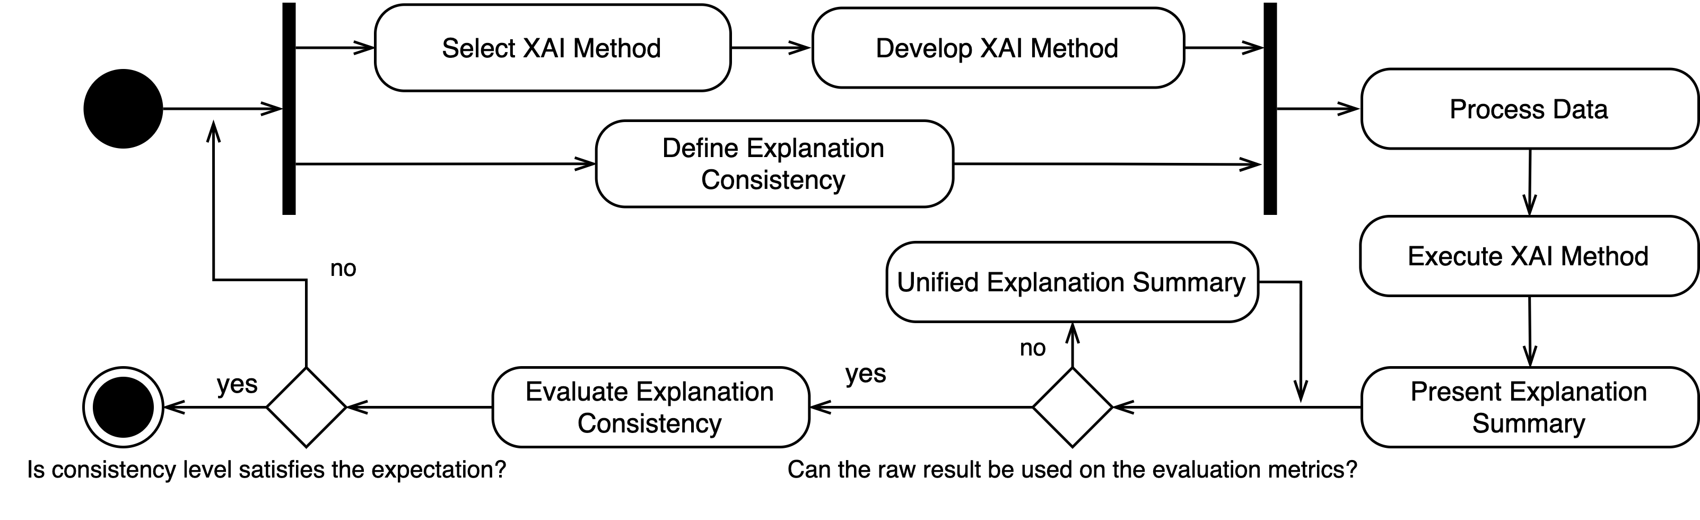
Challenges in XAI Evaluation
XAI techniques bring computational complexity.
Evaluation requires managing diverse data types and integrating explanation methods.
Comparative analysis between the XAI methods will increases workload.
Figure 3. The reference XAI process. [3]
[3] Huang, Jun, Zerui Wang, Ding Li and Yan Liu. “The Analysis and Development of an XAI Process on Feature Contribution Explanation.” 2022 IEEE International Conference on Big Data (Big Data) (2022): 5039-5048.
Notes:
XAI techniques bring explanation to the model, but also bring unique challenges that add significant complexity to the process.
Firstly, evaluating XAI techniques introduces additional computational layers, which increases operational complexity. This complexity is due to several factors.
One major factor is the operational overhead to manage diverse data types. XAI systems often require handling different kinds of data, from images to text to structured tabular data, each with its own set of requirements and challenges.
Another factor is the integration of various explanation methods. XAI methods requiring careful selection and integration to ensure meaningful and accurate explanations.
To thoroughly evaluate the effectiveness of XAI methods, multiple experiments need to be run, each with varying parameters and conditions.
Moreover, comparing XAI techniques against adversarial attacks adds another layer of complexity. Adversarial attacks can exploit vulnerabilities in AI models, making it crucial to assess how well XAI methods can withstand and explain these attacks.
Overall, the process of evaluating XAI is intricate and multifaceted, as illustrated by the XAI process diagram. This diagram highlights the many steps and interactions involved, emphasizing the need for a structured and systematic approach to manage this complexity effectively.

Slide 11
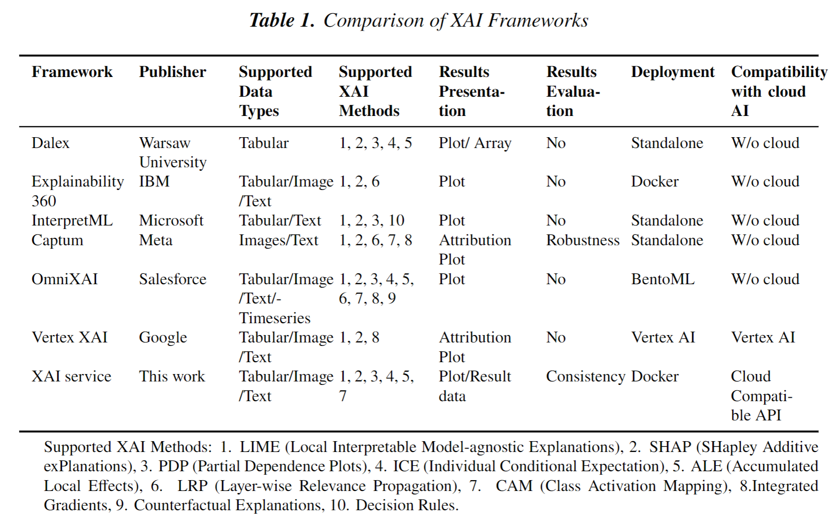


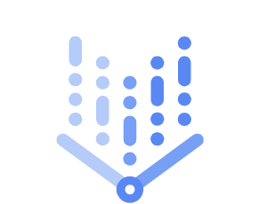

XAI Frameworks
Cloud and Open-source AI Models
Azure Cognitive Services
Amazon Rekognition
Google Cloud Vertex AI
Hugging Face AI Community
*The references in the table are detailed list in the proposal report.

Slide 12
Aspects I - Essentials of XAI Computing
Limitation of the Related Works. Implementation Complexity: Existing methods and frameworks have high development and execution complexity, untraceable procedures, and are difficult to reproduce other’s results.
Cloud Dependency: Cloud-based XAI Solutions dependency on specific platforms and services limits wide external or open-source applicability.
Model-Specific Methods Not Applicable on Cloud Models with the Nature of Black-box: Cloud AI services do not provide the model’s parameter or internal information, which limits the use of model-specific methods.
What are the essential components required for XAI service architecture to deliver feature contribution explanations for models?
How to obtain XAI results without unfolding the cloud AI service model structure?
Notes:
Research

Slide 13
Aspect II – Workflow for Early Adoption of XAI
Limitation of the Related Works.
Lack of end-to-end traceability of XAI data: Lack of comprehensive frameworks for collecting, storing, and analyzing XAI provenance data. This does not provide full traceability and auditability.
Only consider the model’s explainability after the model is developed: Introduces additional refinements work after the machine learning developments.
Research Questions.
Early adoption of XAI refers to the preliminary acceptance and utilization of XAI methodologies in machine learning operations.
How to collect XAI provenance data from operations to enable traceability within the XAI service?
What can early adoption of XAI benefit the ML workflow?
Notes:
Limitations of the SOTA methods, Citation, in each RQs

Slide 14
Aspects III - Metrics to Evaluate the XAI Effects
Limitation of the Related Works.
Computational Overhead: The existing methods and frameworks under explore the XAI performance and cost the of introducing XAI.
Operational Overhead: Integration issues, scalability concerns, and operational adaptability are often overlooked.
Adversarial Perturbations: The resiliency of XAI facing adversarial perturbations remains not examined.
Research Questions.
We aim to assess XAI from consistency, computational efficiency, and robustness perspectives.
What are the operational and computation overhead aspects of implementing XAI?
What effort is needed to integrate the new XAI method?
Within adversarial perturbations, what are the quantifiable correlations between a model's robustness and the explainability?

Slide 15
Segment 2: XAI Service Operation

Slide 16
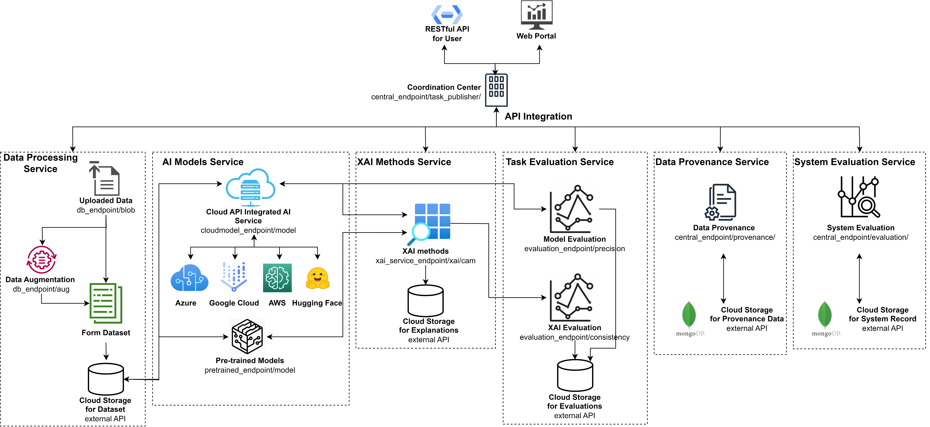
Methodologies - XAI Service Architecture and API Design
What are the essential components required for XAI service architecture to deliver feature contribution explanations for models?
Figure 2. Reference architecture design for XAI service in a microservice-based approach
Wang, Zerui, Yan Liu, and Jun Huang. "An Open API Architecture to Discover the Trustworthy Explanation of Cloud AI Services." IEEE Transactions on Cloud Computing (2024).

Slide 17
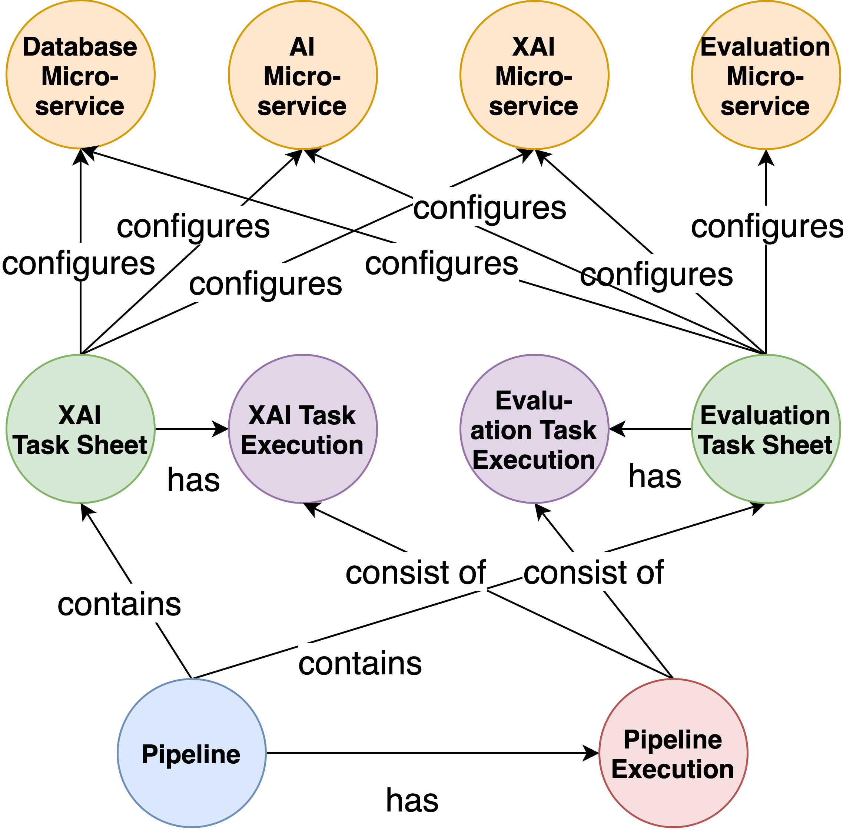
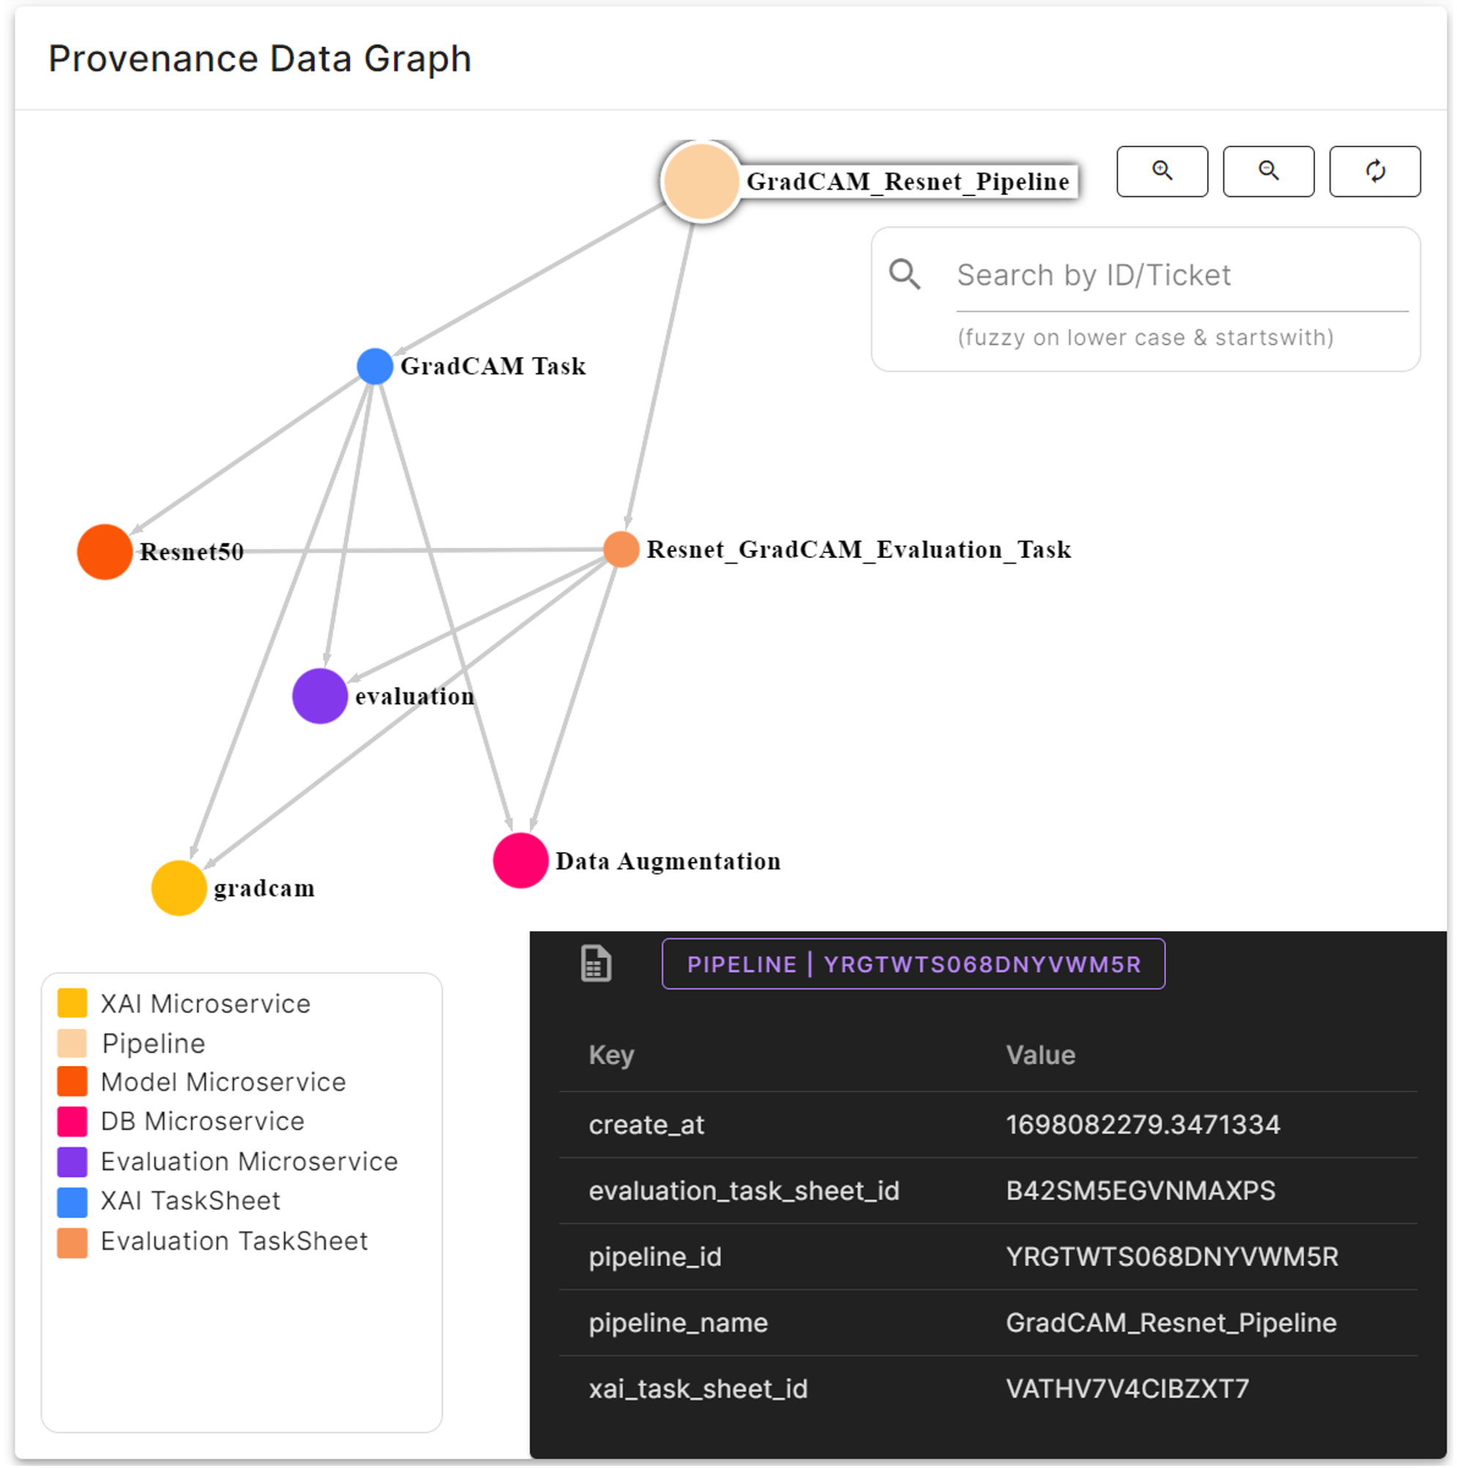
Methodologies - Ensuring Reproducibility in XAI Operations
How to collect XAI provenance data from operations to enable traceability within the XAI service?
Figure 4. Graph representation of nodes and edges for XAI provenance data
Z. Wang, Y. Liu, and J. Huang, "An Open API Architecture to Discover the Trustworthy Explanation of Cloud AI Services," submit to IEEE Transactions on Service Computing, 2023.

Slide 18
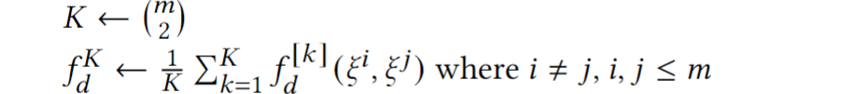
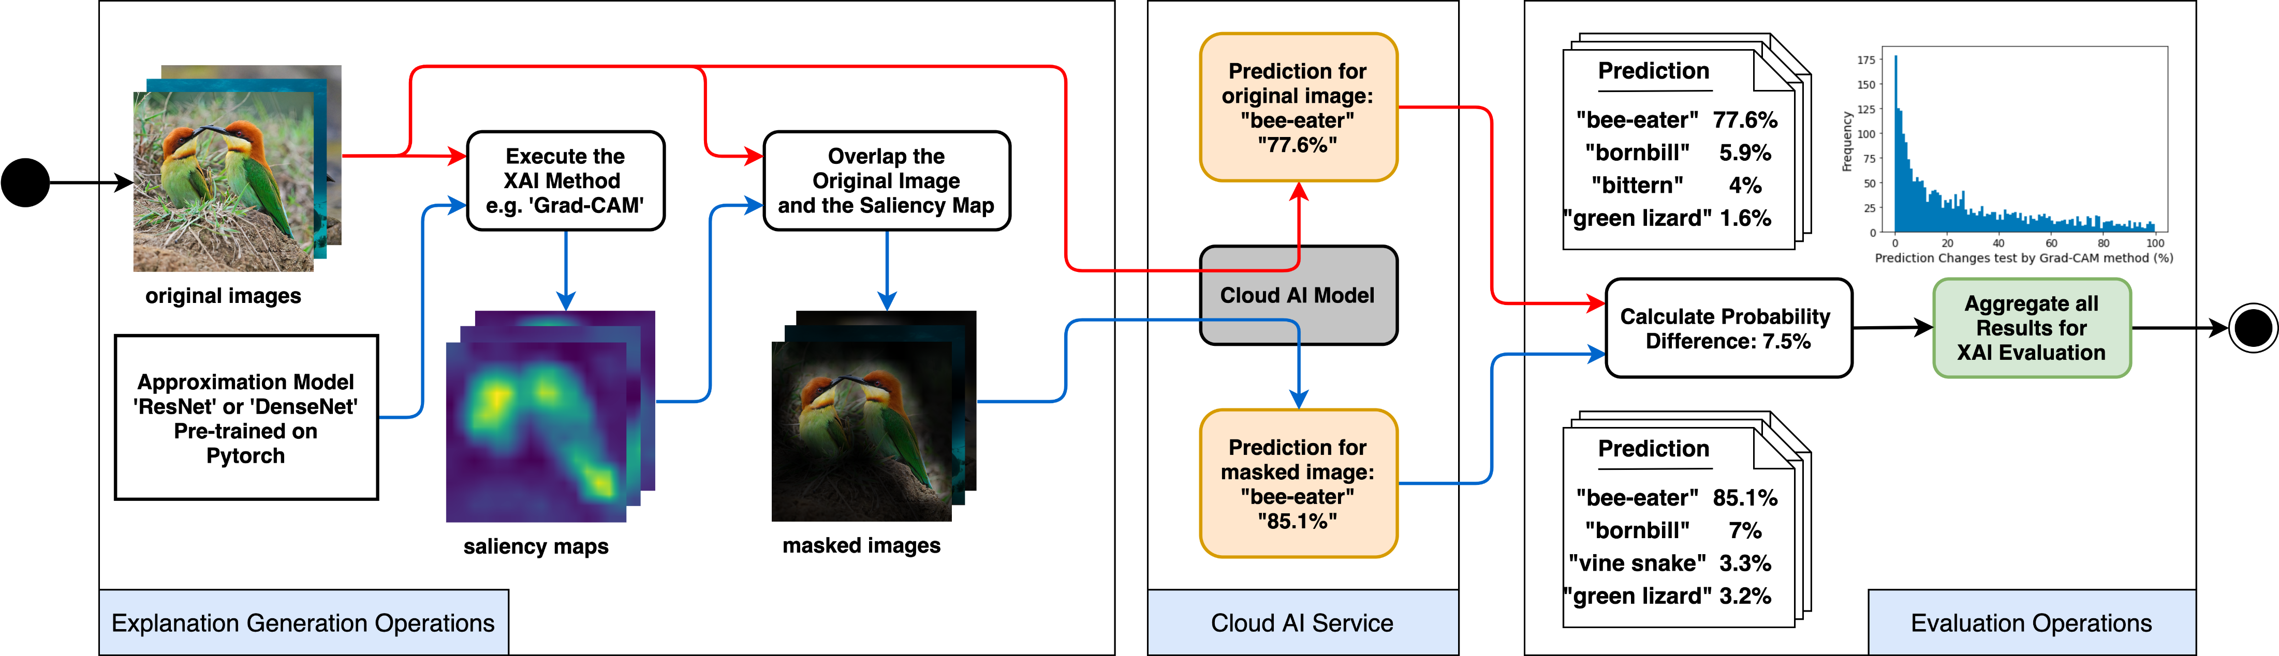
Methodologies – Approximate Black-box Cloud Models
How to obtain XAI results without unfolding the cloud AI service model structure?
Figure 3. The process of integrating cloud AI service with reference models and post hoc XAI methods to approximate feature contribution values

Slide 19
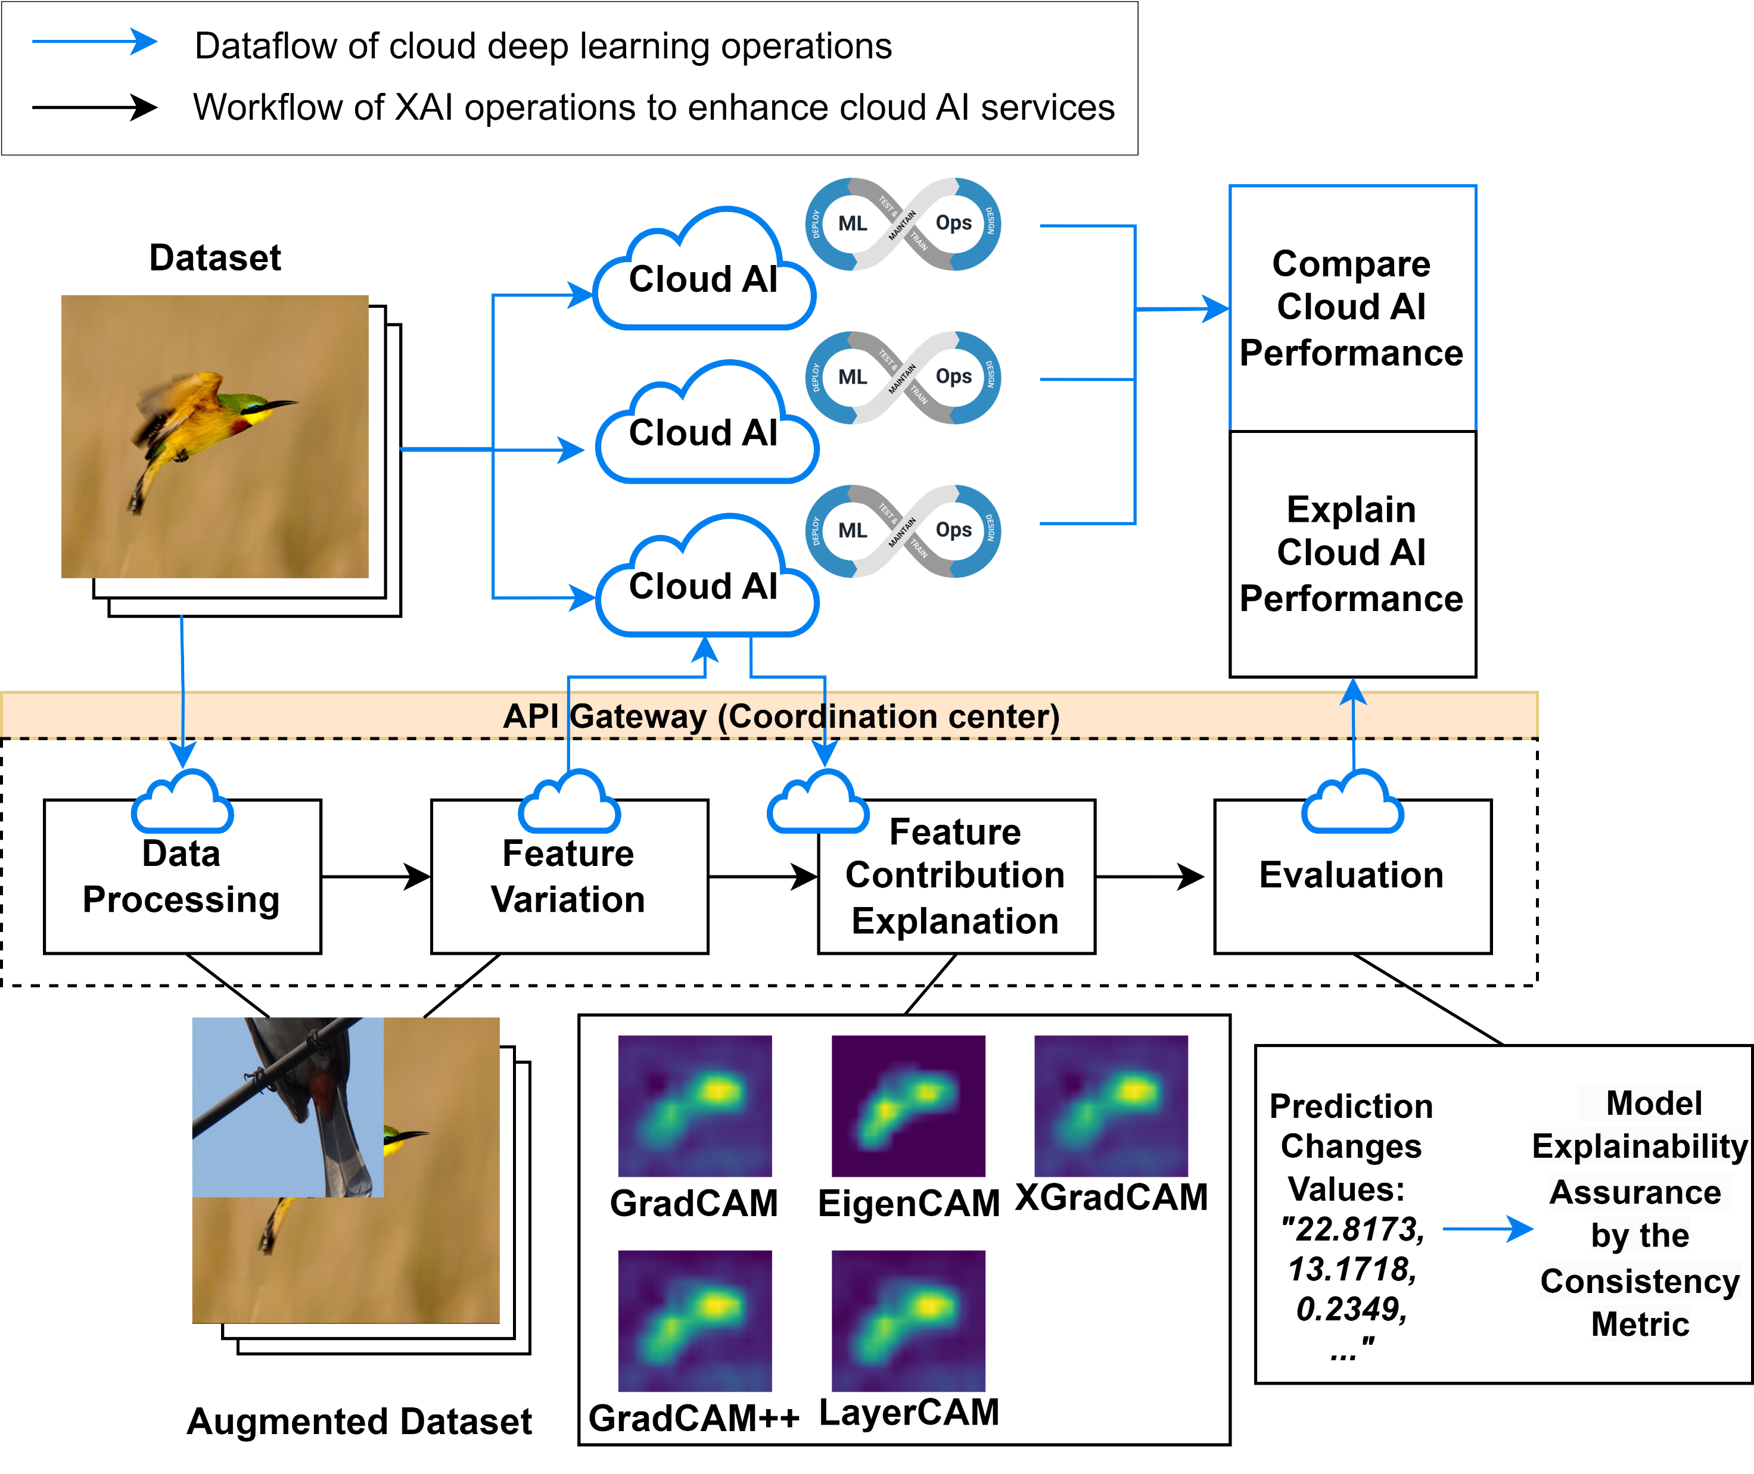
Methodologies - Early Adoption of XAI in ML Development
What can early adoption of XAI benefit the ML workflow?
Support the XAI Compatibility:
The XAI service ensures flexible integration of existing cloud services via open APIs.
Support the Quality of Model’s Explanation:
Explanations generated by XAI methods should adhere to the evaluation metrics, specifically the explanation consistency metrics.
Cost-Efficiency:
The adoption of XAI into MLOps should result in proportional cost-efficient operational overhead.
Z. Wang, Y. Liu, and A. Hamou-Lhadj, "XAIPort: A Framework for the Early Adoption of XAI in Machine Learning Operations, " submit to the International Conference on Software Engineering (ICSE) 2024.
Figure 5. An illustrating scenario of adopting XAI to multiple computer vision cloud AI model development.
Notes:
Support Scripts, Practice

Slide 20
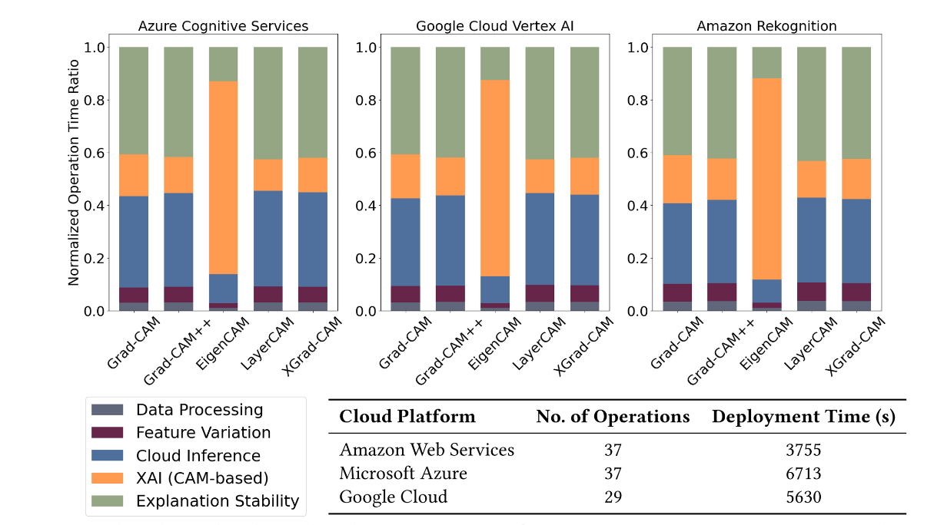
Methodologies – Cost Evaluation
What are the operational and computation overhead aspects of implementing XAI?
Data Processing and Feature Variation time:
Constant time consumption.
Model inference time:
Comparable across cloud services.
XAI time:
Variation by XAI algorithm complexity.
Evaluation time:
A significant ratio in operations.
Figure 6. XAI operations and framework deployment time consumption.
Z. Wang, Y. Liu, and A. Hamou-Lhadj, "XAIPort: A Framework for the Early Adoption of XAI in Machine Learning Operations, " submit to the International Conference on Software Engineering (ICSE) 2024.
Notes:
publicaiton

Slide 21






Methodologies - Pipeline Deployment and Automation
What effort is needed to integrate the new XAI method in XAI operation?
Integration of XAI Algorithms into Microservices:
Modularity: Convert complex XAI algorithms into manageable services.
API Endpoints: Create API endpoints for each XAI service for easy invocation.
Cloud Deployment & Automation:
CI/CD Strategy: Cloud-based continuous integration using AWS CodeBuild.
Deployment Platforms: AWS Elastic Container Service, Azure Container Instance, Azure VMs, Google Kubernetes Engine.
Environment: Cloud-agnostic with platform-independent IaC & cloud CLI.
Reproducibility in XAI Pipeline:
Importance: Ensures transparent & consistent operations across datasets and environments.
Solution: Use data provenance for traceability & transparency.
Azure VMs

Slide 22
Segment 3: XAI Application Scenarios and Future Directions

Slide 23
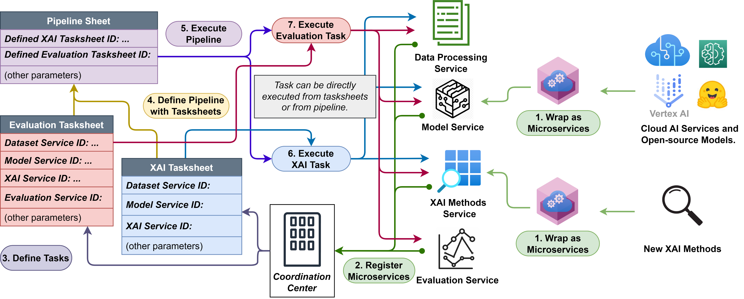
XAI Discovery Scenarios Scenario One: Automating XAI Operations Pipeline
Figure 7. XAI operations pipeline.
This scenario showcases the practical utility of the Workflow for Early adoption of XAI.
The architecture enables integration with developing cloud-based AI services and provides flexibility for implementing diverse explainability methods through open APIs. Various XAI methods display different performances through consistency evaluations. The evaluation ensures the model’s explainability.
Z. Wang, J. Huang, A. Thiruselvi, H. Kandikattu, Y. Liu, "An Explanation Framework for Quality Assurance in Cloud and Open-source AI Models, " submit to the International Conference on Software Engineering (ICSE) 2024, Demonstration Track.
Notes:
Citation,algorithm not clear, Automating XAI pipelines

Slide 24
Pipelines of XAI Centric Assessment of Quality Attributes
Figure 5. Assessment Pipelines for Open-source AI Model Quality Attributes
Notes:
We orgnize pipelines that provide quality attributes assessments.
To comprehensively evaluate AI models, we define several quality attributes: computational cost, performance, robustness, explanation deviation, and explanation resilience. These attributes provide a holistic view of the models' capabilities and limitations.
Computational cost measures the resources required to execute an algorithm, including CPU, GPU, and memory utilization. It also considers runtime and energy consumption. We use the CodeCarbon library to track resource utilization and estimate the environmental impact.
Model performance is evaluated using metrics such as precision, recall, F1 score. These metrics provide a comprehensive assessment of the model's accuracy and ability to distinguish between classes.
Robustness evaluation measures a model's performance degradation under adversarial conditions. We use the Kolmogorov-Smirnov (K-S) statistic to compare the prediction distributions of original and perturbed datasets, providing a quantitative measure of robustness.
Explanation deviation assesses the impact of feature importance explanations on model outputs. We measure this by calculating the prediction change score, which indicates how much the model's predictions change when important features are emphasized.
Explanation resilience measures the difference in explanation deviation between non-adversarial and adversarial conditions. It quantifies how well explanations hold up under adversarial attacks, providing insights into the robustness of the explanations themselves.
Our framework defines specific pipelines for evaluating each quality attribute. These pipelines are configurable for different AI models, XAI methods, and adversarial datasets, enabling a comprehensive and systematic evaluation process.

Slide 25
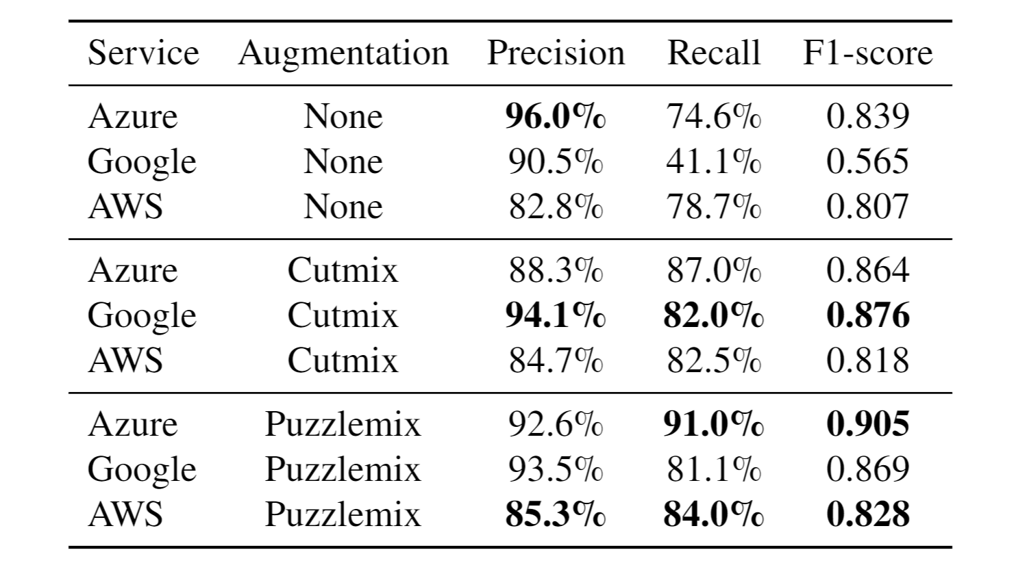
Scenario Two: Cloud AI Learning Performance Evaluation
Table 3. Comparison of the model metrics provided by the cloud AI Services under different data augmentation strategies
The use of data augmentation strategies improves the performance metrics of cloud-based AI services.
The enhancement is achieved without the expansion of the training dataset.

Slide 26
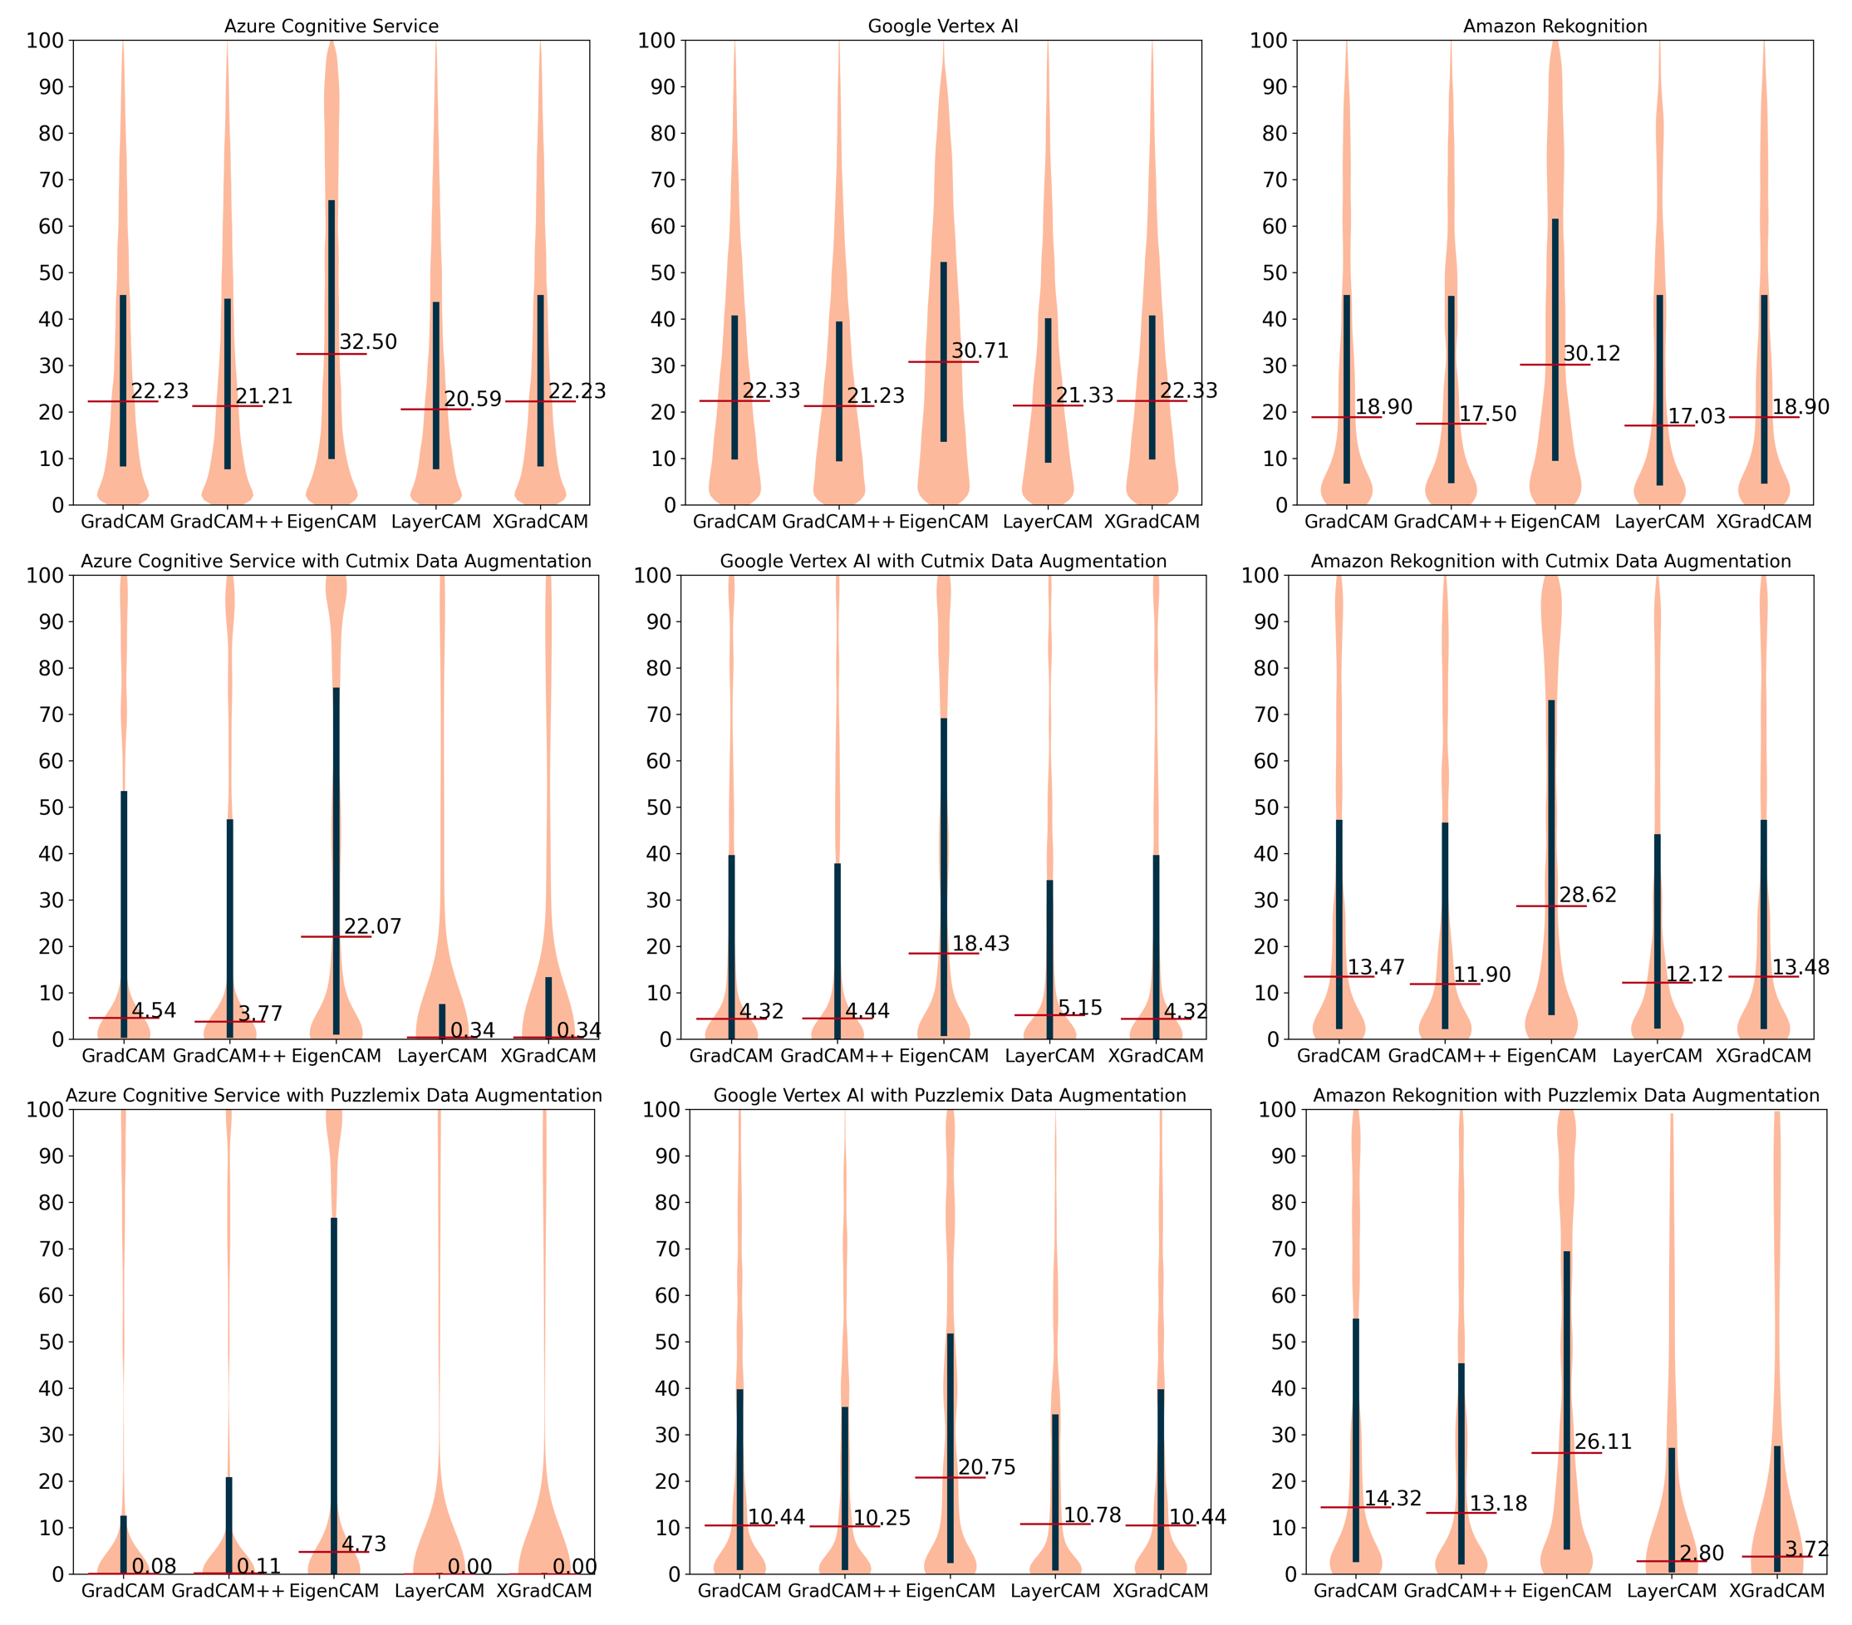
Scenario Three: Probing of Data Augmentation Effects
A significant enhancement in model explainability with the data augmentation techniques.
Z. Wang, Y. Liu, and J. Huang, "An Open API Architecture to Discover the Trustworthy Explanation of Cloud AI Services," submit to IEEE Transactions on Service Computing, 2023. Submitted
Figure 8. The explanation consistency evaluation for the three original cloud AI models

Slide 27
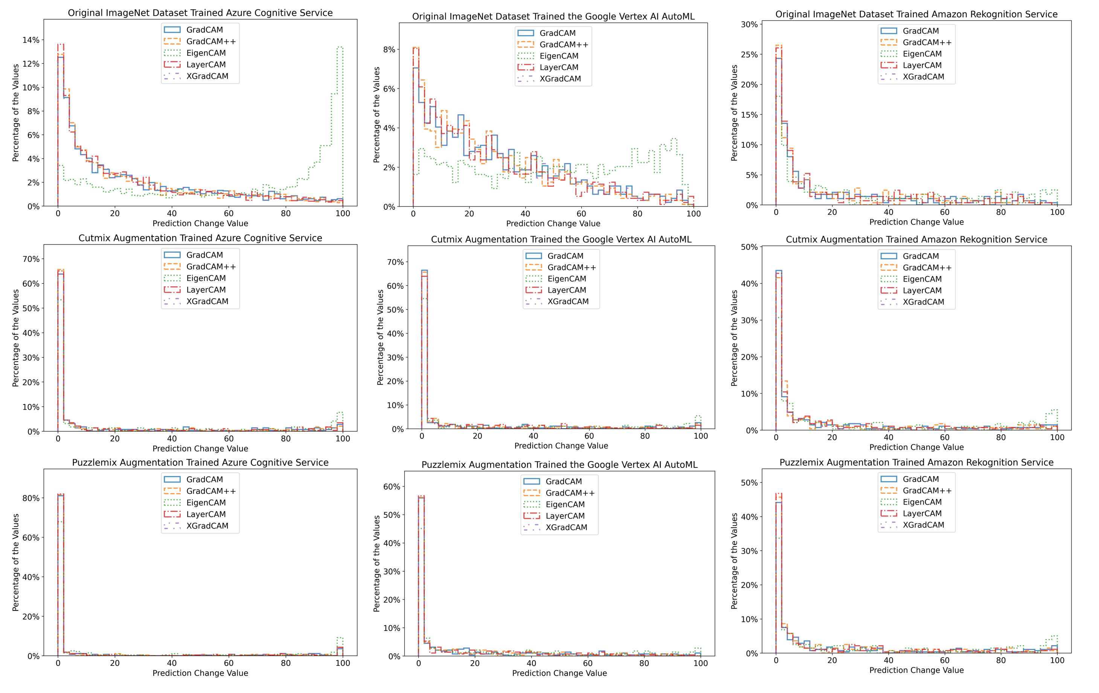
Observation of the Improvement to the Cloud AI’s Explainability -Azure Cognitive Service
Figure 9 (a). The percentage of the prediction change in the test dataset using multiple augmentation, CAM-based XAI methods on multiple cloud AI services
This scenario shows that advanced data augmentation techniques, including CutMix and PuzzleMix, significantly improve both the performance and XAI evaluation of AI models. The scenario highlights the need for multifaceted evaluation approaches that consider XAI-based assessments to understand model effectiveness.
Z. Wang, Y. Liu, and J. Huang, "An Open API Architecture to Discover the Trustworthy Explanation of Cloud AI Services," submit to IEEE Transactions on Service Computing, 2023. Submitted

Slide 28
Observation of the Improvement to the Cloud AI’s Explainability
-Google Vertex AI
Figure 9 (b). The percentage of the prediction change in the test dataset using multiple augmentation, CAM-based XAI methods on multiple cloud AI services
Z. Wang, Y. Liu, and J. Huang, "An Open API Architecture to Discover the Trustworthy Explanation of Cloud AI Services," submit to IEEE Transactions on Service Computing, 2023. Submitted

Slide 29
Observation of the Improvement to the Cloud AI’s explainability
Amazon Rekognition
Figure 9 (c). The percentage of the prediction change in the test dataset using multiple augmentation, CAM-based XAI methods on multiple cloud AI services
Z. Wang, Y. Liu, and J. Huang, "An Open API Architecture to Discover the Trustworthy Explanation of Cloud AI Services," submit to IEEE Transactions on Service Computing, 2023. Submitted

Slide 30

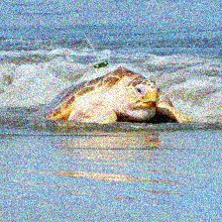

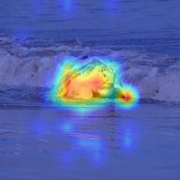






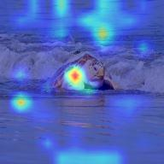



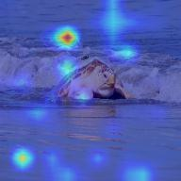
Scenario - Applying Adversarial Perturbation
Within adversarial perturbations, what are the quantifiable correlations between a model's robustness and the consistency of its XAI-driven explanations?
Adversarial Perturbation
XAI Methods
Gaussian Noise level 2
Gaussian Noise level 3
Gaussian Noise level 1
LayerCAM
GradCAM
Original
GradCAM++
Defocus Blur level 3
XGradCAM
Defocus Blur level 2
Defocus Blur level 1
10,000 images in
1000 categories
HiResCAM
Pixelate level 2
Pixelate level 3
Pixelate level 1
Hendrycks, Dan, and Thomas Dietterich. "Benchmarking neural network robustness to common corruptions and perturbations." arXiv preprint arXiv:1903.12261 (2019). ICLR
Notes:
Figure group titles

Slide 31
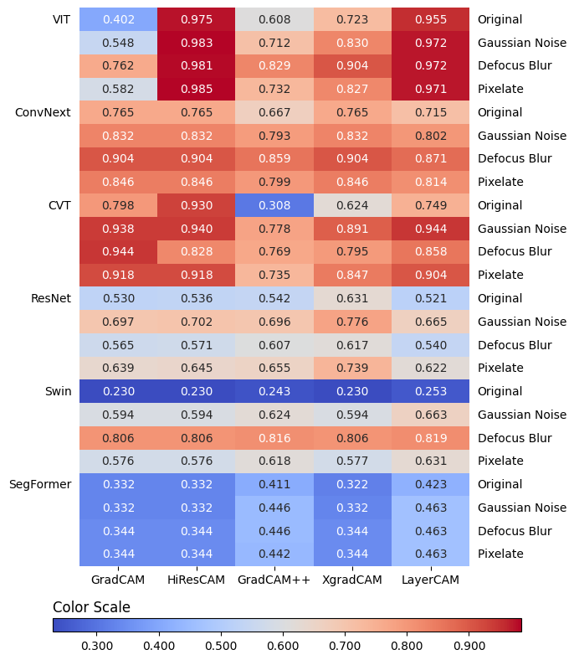
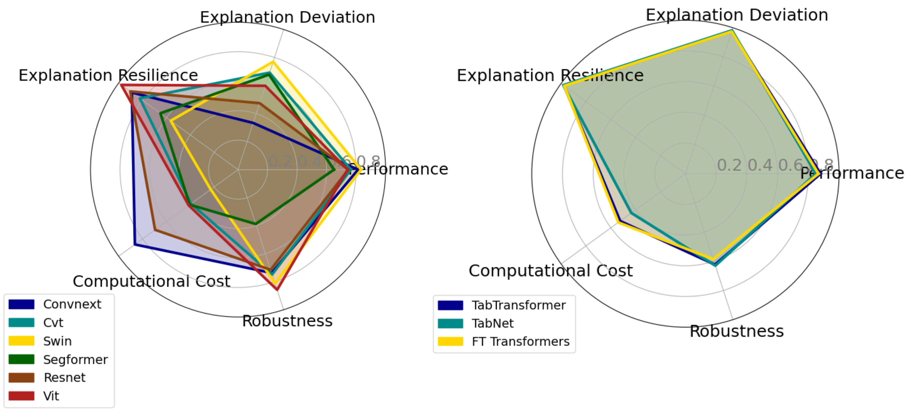
Scenario Study Results - Vision Models
Swin Transformer has high explanation deviation and computational cost.
ViT and Swin are robust against adversarial attacks.
ConvNeXt needs lower computational cost but less robust.
Figure 8. Heatmaps Illustrating Median Prediction Change Percentage for Original and Adversarial Perturbed Images.
(Lower Values Indicate Better Explanation Deviation.)
Figure 7. Multiple Quality Attributes Assessment for the Vision Models.
Notes:
"In our scenario studies, we assessed six vision models against three types of adversarial attacks using five XAI methods, resulting in ninety distinct combinations. Additionally, we evaluated three transformer-based tabular models with two XAI methods across three datasets, yielding eighteen combinations. This comprehensive approach allowed us to evaluate various quality attributes, including computational cost, performance, robustness, explanation deviation, and explanation resilience."
"In our evaluation of vision models, we analyzed computational costs, model performance, robustness, explanation deviation, and explanation resilience. The Swin Transformer demonstrated high explanation deviation and computational cost, while ViT and Swin exhibited robustness against adversarial attacks. On the other hand, ConvNeXt showed lower computational cost but less robustness."

Slide 32
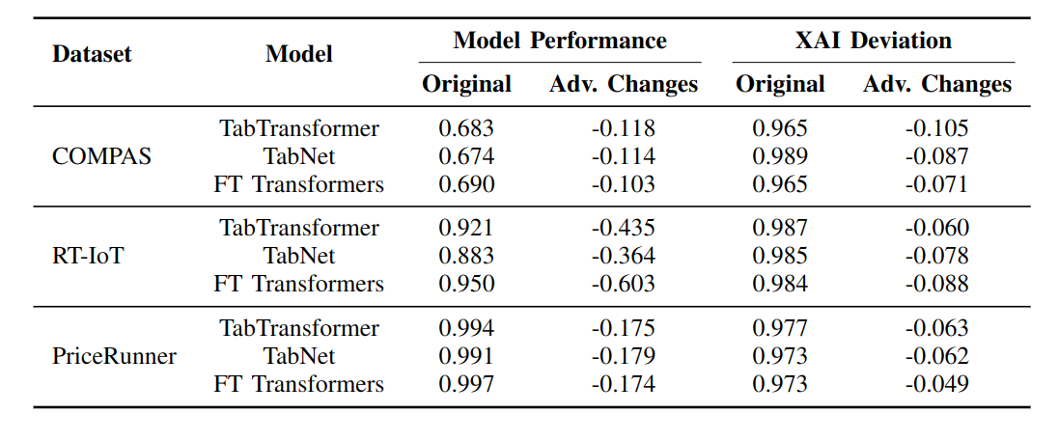

Scenario Study Results - Tabular Models
Table 2. Tabular Model and XAI Assessment Results
Datasets：
COMPAS: Recidivism Risk Score Data
RT-IoT2022: Cybersecurity Threats Dataset
PriceRunner: Product Classification and Clustering
Models：
TabTransformer: Adapts Transformer architecture for tabular data
TabNet: Utilizes sequential attention for feature selection
FT Transformers: Optimizes Transformer model for numerical features
XAI Methods：
Mean Centroid Prediff
SHAP
Figure 10. Multiple Quality Attributes Assessment for the Tabular Models.
Notes:
This is the scenario results for tabular data.
Our study uses three key datasets: COMPAS for recidivism risk, RT-IoT2022 for cybersecurity threats, and PriceRunner for product classification. The models we employed are TabTransformer, TabNet, and FT Transformers, each tailored for tabular data. We also applied Mean Centroid Prediff and SHAP as our XAI methods.
This table shows the performance metrics before and after adversarial perturbations. We observed a significant decrease in performance, especially for the RT-IoT dataset. The explanation deviation also showed noticeable changes under adversarial conditions.
Mean Centroid Prediff exhibited superior resilience compared to SHAP, although it incurred higher computational demands."
Finally, our radar chart provides a comparative analysis of selected models across various quality attributes. This evaluation aims to support engineers in selecting and developing explainable models in AI-enabled software.

Slide 33
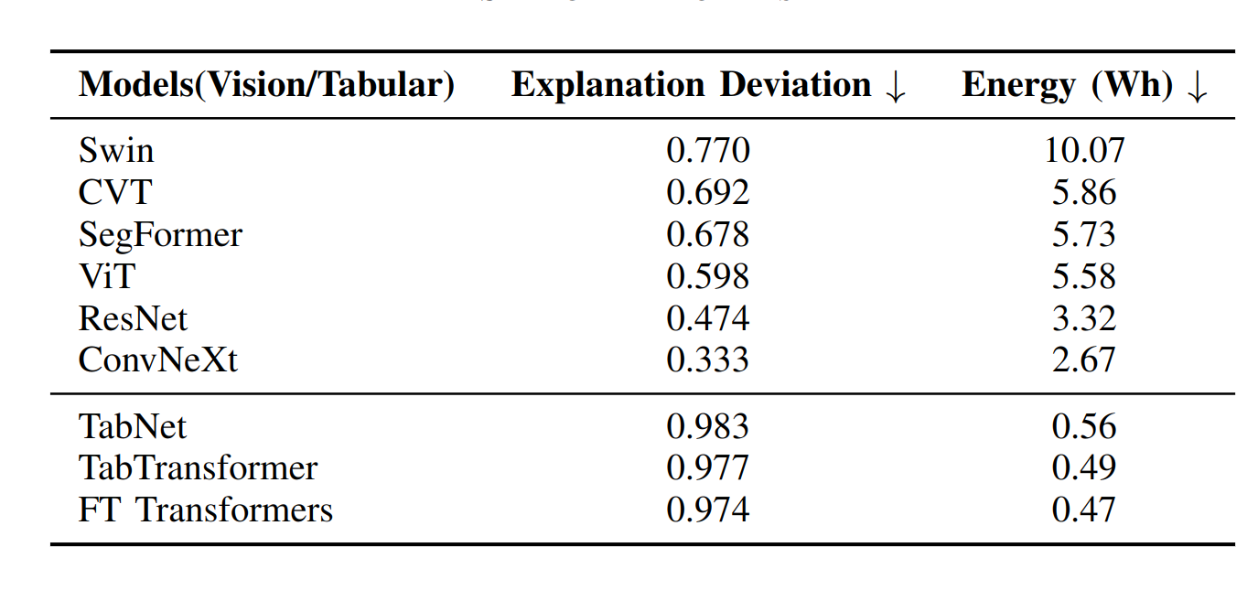
Conclusion
1. Explanation Deviation (RQ1)
Varies across models.
Cloud-based XAI service simplifies assessment.
2. Computational Cost (RQ2)
XAI methods are expensive.
Balance explanation quality with efficiency.
3. Adversarial Impact (RQ3)
Adversarial attacks degrade performance and explanations.
Automated framework enhances robustness.
Figure 11. Multiple Quality Attributes Assessment for the Selected Models.
Table 3. Explanation Deviation and Energy Consumption of the Selected Models
Notes:
"Let's summarize our key findings:
1. Explanation Deviation (RQ1)
Explanation deviation varies significantly across different models. Our cloud-based XAI service makes assessing these deviations much simpler.
2. Computational Cost (RQ2)
XAI methods are computationally expensive. It's essential to balance achieving high explanation quality with managing computational costs efficiently.
3. Adversarial Impact (RQ3)
Adversarial attacks negatively impact both model performance and explanation quality. Our automated framework helps in assessing and improving robustness against these attacks.
These insights highlight the need for a balanced approach in developing explainable AI models, considering performance, cost, and robustness."

Slide 34
Conclusion
Contributions from XAI Service Research
Core Components of XAI: Designed and developed the essential components critical for XAI architecture.
Explain Black-box Cloud Models: Introduced an innovative method allowing XAI result extraction without requiring the internal parameter of AI models.
Provenance & Traceability in XAI Operations: Pioneered a methodology ensuring effective and traceable XAI data collection, enhancing the reproducible of XAI operations.
Early XAI Adoption in ML Workflow: Emphasized and showcased the benefits of early adopting XAI in the ML development process for the model’s explanation quality assurance.
Measure XAI Overheads: Provided operational and computational costs added by XAI, show the work for future optimizations.
New Cloud AI, Open-source Model, and XAI Integration: Provide an actionable framework for the integration of emerging AI models and XAI methods.

Slide 35
Scholarly Contributions
Publication:
J. Huang*, Z. Wang*, D. Li and Y. Liu, "The Analysis and Development of an XAI Process on Feature Contribution Explanation," 2022 IEEE International Conference on Big Data (Big Data), Osaka, Japan, 2022, pp. 5039-5048, doi: 10.1109/BigData55660.2022.10020313.
Z. Wang, Y. Liu, and J. Huang, "An Open API Architecture to Discover the Trustworthy Explanation of Cloud AI Services," submit to IEEE Transactions on Service Computing, 2023.
Z. Wang, Y. Liu, and A. Hamou-Lhadj, "XAIPort: A Framework for the Early Adoption of XAI in Machine Learning Operations, " submit to the International Conference on Software Engineering (ICSE) 2024.
Z. Wang and Y. Liu, "Cloud-Based XAI Services for Assessing Open Repository Models Under Adversarial Attacks," in 2024 IEEE International Conference on Software Services Engineering (SSE), Shenzhen, China, 2024 pp. 141-152. doi: 10.1109/SSE62657.2024.00031

Slide 36
Future Work
Investigate

Slide 37
Thanks!

Slide 38
Appendix

Slide 39
Grad-CAM (Gradient-weighted Class Activation Mapping)
Grad-CAM utilizes gradient information flowing into the last convolutional layer of the CNN to understand which regions of the image are important for making a decision.
It computes the gradients of the target class score with respect to the feature maps of a convolutional layer.
These gradients are globally averaged to obtain the importance weights for each feature map.
The feature maps are then multiplied by these weights and summed to create the final heatmap.
Grad-CAM is the original method among these and provides a relatively straightforward way to highlight important image regions but may not produce the most precise heatmaps.

Slide 40
Grad-CAM++
Grad-CAM++ is an improved version of Grad-CAM that addresses its shortcomings in dealing with multiple and partial objects.
It incorporates higher-order gradient information to capture finer details of the targets.
Grad-CAM++ is better at handling situations with multiple objects present and provides more detailed visualizations.

Slide 41
EigenCAM
EigenCAM does not rely on gradient information but uses Principal Component Analysis (PCA) of the activations in a convolutional layer to identify the most significant features.
It extracts the principal components by performing eigendecomposition on the covariance matrix of the feature maps.
These components represent the main visual patterns in the image.
EigenCAM avoids the need for gradient backpropagation, but it might not capture details that are specific to a particular class.

Slide 42
LayerCAM
LayerCAM improves the localization capability of Grad-CAM by adding a modified pixel-wise weight to the basic Grad-CAM formulation.
It combines the activations and gradients at each pixel rather than averaging the gradients globally.
LayerCAM provides more refined localization heatmaps, especially on the edges of objects within images.

Slide 43
XGrad-CAM
It improves upon Grad-CAM by normalizing the gradients and activations, retaining more spatial information.
XGrad-CAM produces heatmaps that are more consistent and have stronger explanatory power compared to the original Grad-CAM.

